Slide 1
Introduction to Machine Learning
Session 01-02

Slide 2
Learning Outcome
LO 1: Explain the fundamental of machine learning concept
LO 2: Interpret the distribution of dataset using regression method
LO 3: Experiment classification and clustering algorithm from given dataset

Slide 3
Outline
Current trends of Artificial Intelligence
Differences Between AI and Machine Learning
Type of Machine Learning based on Learning Problem.
Type of Machine Learning Based on Learning Techniques

Slide 4
Current Trends of Artificial Intelligence

Slide 5

Current trends of Artificial Intelligence
AI Generation

Slide 6

Current trends of Artificial Intelligence
AI Generation

Slide 7
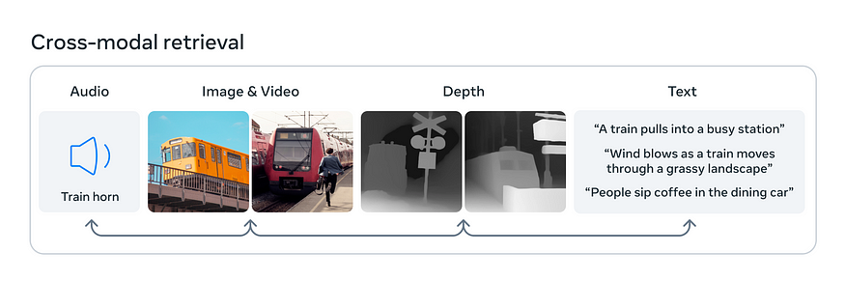
Current trends of Artificial Intelligence
Multi-modal

Slide 8
Differences Between AI and Machine Learning

Slide 9
Differences Between AI and Machine Learning
Artificial intelligence is a wide-ranging field focused on creating machines and computers that can perform tasks similar to human thinking.
This includes seeing, understanding spoken or written language, analyzing data, making suggestions, and other abilities.
Machine learning is a part of artificial intelligence where machines or systems learn and get better on their own from experience.
Rather than being specifically programmed, they use algorithms to process large data sets, learn from them, and then make decisions based on what they have learned.

Slide 10
Differences Between AI and Machine Learning
While AI and ML are not quite the same thing, they are closely connected. The simplest way to understand how AI and ML relate to each other is:
AI is the broader concept of enabling a machine or system to sense, reason, act, or adapt like a human
ML is an application of AI that allows machines to extract knowledge from data and learn from it autonomously
What is the main difference between AI and Machine Learning?
Artificial intelligence encompasses the idea of a machine that can mimic human intelligence. Machine learning aims to teach a machine how to perform a specific task and provide accurate results by identifying patterns.

Slide 11

Differences Between AI and Machine Learning
Source Image: https://towardsdatascience.com/cousins-of-artificial-intelligence-dda4edc27b55

Slide 12
Differences Between AI and Machine Learning
Artificial intelligence
AI allows a machine to simulate human intelligence to solve problems
The goal is to develop an intelligent system that can perform complex tasks
We build systems that can solve complex tasks like a human
AI has a wide scope of applications
AI uses technologies in a system so that it mimics human decision-making
AI works with all types of data: structured, semi-structured, and unstructured
AI systems use logic and decision trees to learn, reason, and self-correct
Machine learning
ML allows a machine to learn autonomously from past data
The goal is to build machines that can learn from data to increase the accuracy of the output
We train machines with data to perform specific tasks and deliver accurate results
Machine learning has a limited scope of applications
ML uses self-learning algorithms to produce predictive models
ML can only use structured and semi-structured data
ML systems rely on statistical models to learn and can self-correct when provided with new data

Slide 13
Type of Machine Learning based on Learning Problem.

Slide 14
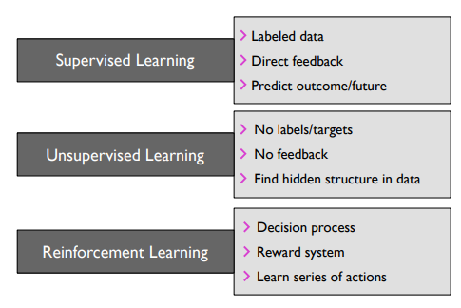
Type of Machine Learning based on Learning Problem
The three broad categories of machine learning are summarized in
Supervised learing
unsupervised learning,
reinforcement learning

Slide 15
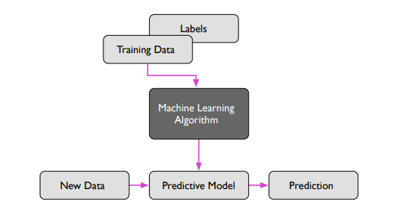
Type of Machine Learning based on Learning Problem
Supervised Learning
Supervised learning is the subcategory of machine learning that focuses on learning a classification or regression model.
Supervised learning is, learning from labeled training data (i.e., inputs that also contain the desired outputs or targets; basically, “examples” of what we want to predict).

Slide 16

Type of Machine Learning based on Learning Problem
Supervised Learning
Which one is a dog? which one is a cat?

Slide 17

Type of Machine Learning based on Learning Problem
Supervised Learning
Which one is a llama? which one is a alpaca?

Slide 18
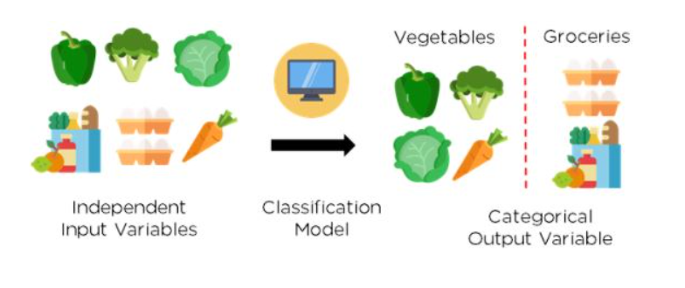
Type of Machine Learning based on Learning Problem
Supervised Learning
Classification is defined as the process of recognition, understanding, and grouping of objects and ideas into preset categories a.k.a “sub-populations.”
With the help of these pre-categorized training datasets, classification in machine learning programs leverage a wide range of algorithms to classify future datasets into respective and relevant categories.

Slide 19
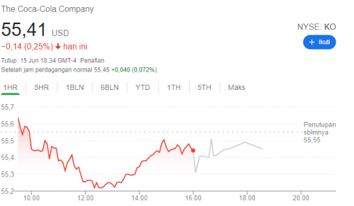
Type of Machine Learning based on Learning Problem
Supervised Learning
Can you predict the stock price of coca cola for 20:00?

Slide 20
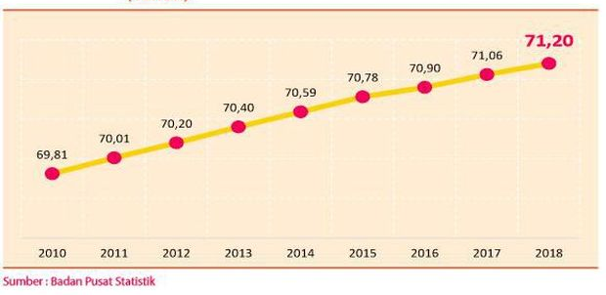
Type of Machine Learning based on Learning Problem
Supervised Learning
life expectancy
Can you predict the life expectancy in 2020?

Slide 21
Type of Machine Learning based on Learning Problem
Supervised Learning
Regression in machine learning is a technique used to capture the relationships between independent and dependent variables, with the main purpose of predicting an outcome.

Slide 22
Type of Machine Learning based on Learning Problem
Regression vs Classification
Regression Algorithm | Classification Algorithm
In Regression, the output variable must be of continuous nature or real value. | In Classification, the output variable must be a discrete value.
In Regression, we try to find the best fit line, which can predict the output more accurately. | In Classification, we try to find the decision boundary, which can divide the dataset into different classes.
Example: Weather Prediction, House price prediction, etc. | Example : Identification of spam emails, Speech Recognition, Identification of cancer cells, etc.

Slide 23
Type of Machine Learning based on Learning Problem
Unsupervised Learning
Unsupervised learning is a branch of machine learning that is concerned with unlabeled data.
Common tasks in unsupervised learning are clustering analysis (assigning group memberships) and dimensionality reduction (compressing data onto a lower-dimensional subspace or manifold).

Slide 24

Type of Machine Learning based on Learning Problem
Unsupervised Learning
Find a group from the following picture based on whether the animal has wings or not?

Slide 25
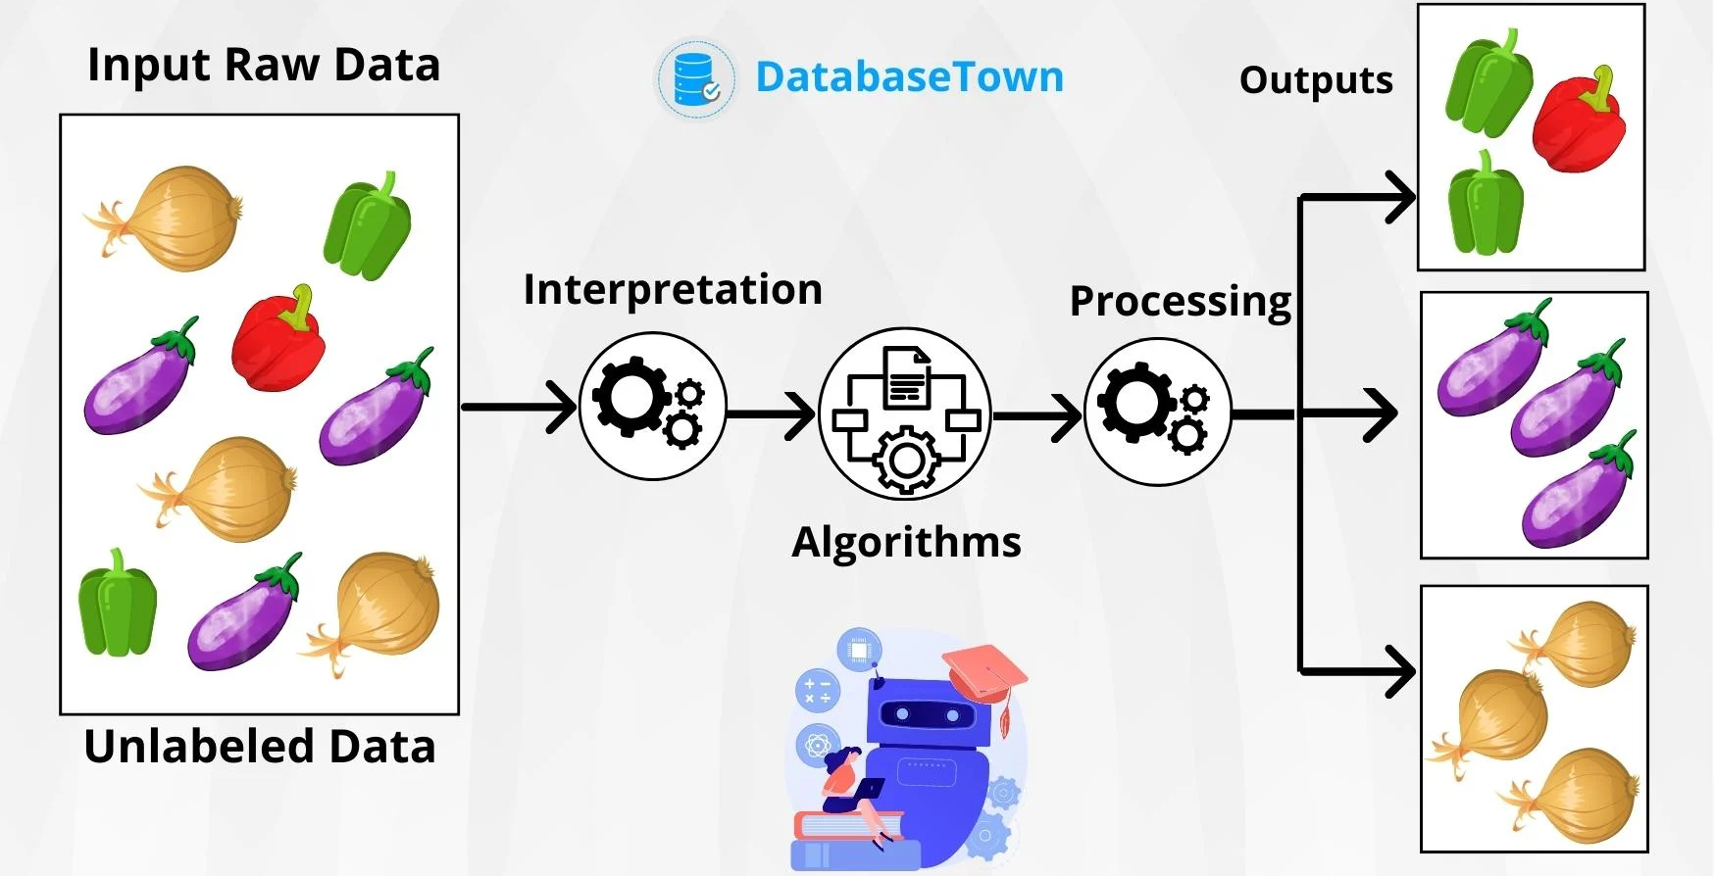
Type of Machine Learning based on Learning Problem
Unsupervised Learning
Clustering is the task of dividing the unlabeled data or data points into different clusters such that similar data points fall in the same cluster than those which differ from the others.

Slide 26
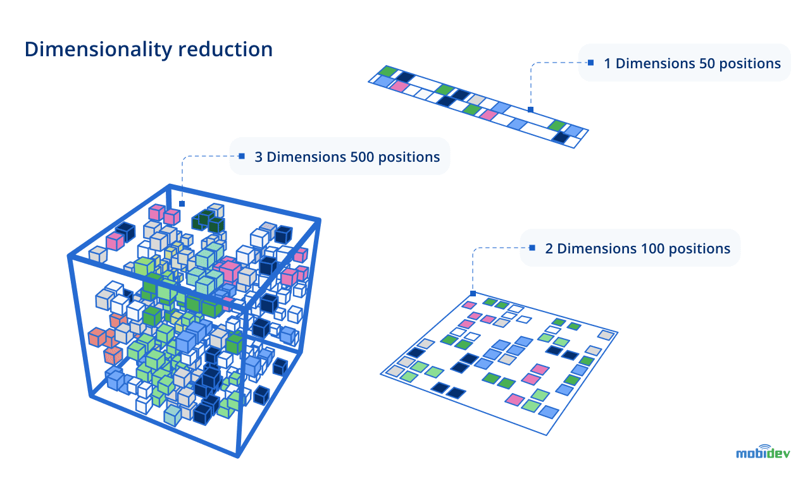
Type of Machine Learning based on Learning Problem
Unsupervised Learning
Dimensionality reduction is the process of reducing the number of features or dimensions in a dataset, while preserving the most important information.
The objectives of dimensionality reduction are to visualize data easier, understand and analyze, and to improve the performance of ML models.

Slide 27
Type of Machine Learning based on Learning Problem
Reinforcement Learning
Reinforcement learning (RL) is a subset of machine learning that allows an AI-driven system (sometimes referred to as an agent) to learn through trial and error using feedback from its actions
This feedback is either negative or positive, signaled as punishment or reward with, of course, the aim of maximizing the reward function.
Difference between Reinforcement learning and supervised-unsupervised learning,
In supervised learning, the feedback contains the correct set of actions for the agent to follow. In RL there is no such answer key. The agent decides what to do itself to perform the task correctly.
The goal of unsupervised learning is to find similarities or differences between data points. RL’s goal is to find the most suitable action model to maximize total cumulative reward for the RL agent. With no training dataset, the RL problem is solved by the agent’s own actions with input from the environment

Slide 28
Type of Machine Learning based on Learning Problem
Reinforcement Learning
There are three types of RL implementations:
Policy-based RL uses a policy or deterministic strategy that maximizes cumulative reward
Value-based RL tries to maximize an arbitrary value function
Model-based RL creates a virtual model for a certain environment and the agent learns to perform within those constraints

Slide 29
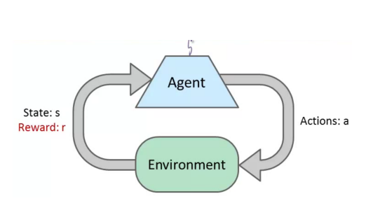
Type of Machine Learning based on Learning Problem
Reinforcement Learning
How does RL work?
The best way to understand reinforcement learning is through video games, which follow a reward and punishment mechanism
In a game, you play a character who is the agent that exists within a particular environment.
The scenarios they encounter are analogous to a state.
Your character or agent reacts by performing an action, which takes them from one state to a new state.
After this transition, they may receive a reward or punishment.
The policy is the strategy which dictates the actions the agent takes as a function of the agent’s state as well as the environment.

Slide 30

Reinforcement Learning Concept

Slide 31

Reinforcement Learning Concept

Slide 32
Type of Machine Learning based on Learning Techniques.

Slide 33
Type of Machine Learning based on Learning Techniques
There are mainly two approaches to how ML applications can learn in production, Online and Batch

Slide 34
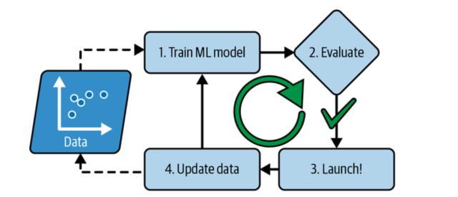
Type of Machine Learning based on Learning Techniques
Batch Learning
Batch learning represents the training of machine learning models in a batch manner.
In batch learning, the system is not capable of learning incrementally
The models must be trained using all the available data every single time.
The models then get trained with the accumulated data from time to time at periodic intervals.
This model training takes a lot of time and computing resources. Hence, it is typically done offline.

Slide 35
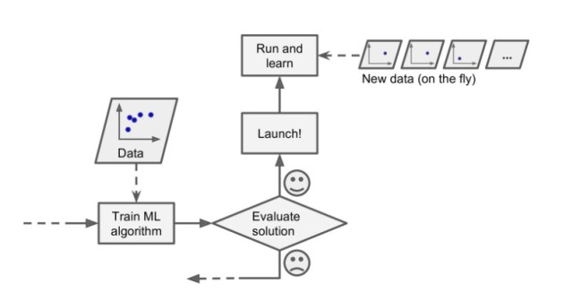
Type of Machine Learning based on Learning Techniques
Online Learning
In online learning, the training happens in an incremental manner by continuously feeding data as it arrives or in a small group / mini batches
Each learning step is fast and cheap, so the system can learn about new data on the fly, as it arrives.
Online learning is great for machine learning systems that receive data as a continuous flow (e.g., stock prices) and need to adapt to change rapidly or autonomously
It is also a good option if you have limited computing resources

Slide 36
Machine Learning Lifecycle

Slide 37
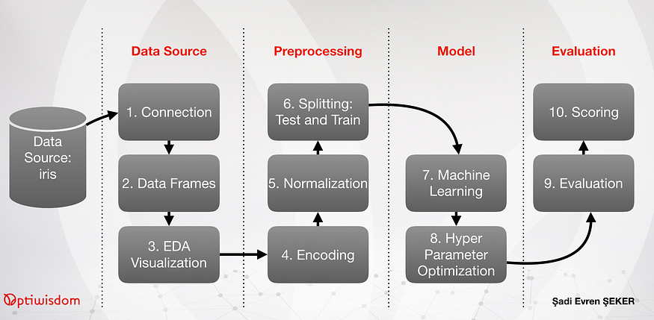
Machine Learning Lifecycle

Slide 38
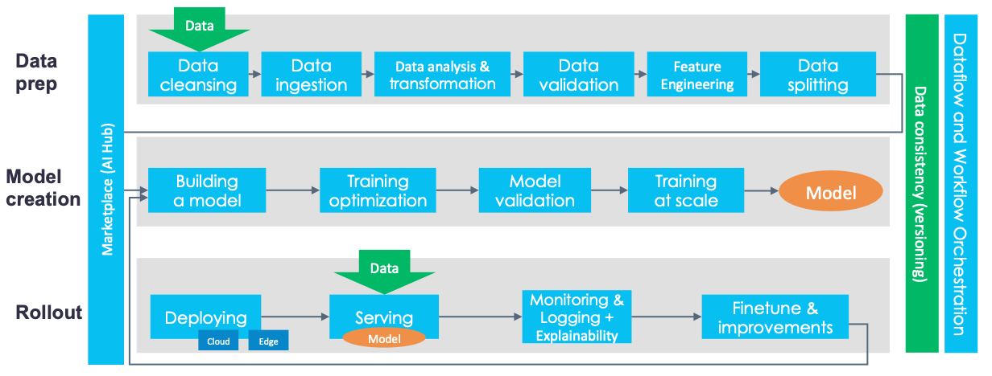
Machine Learning Lifecycle

Slide 39
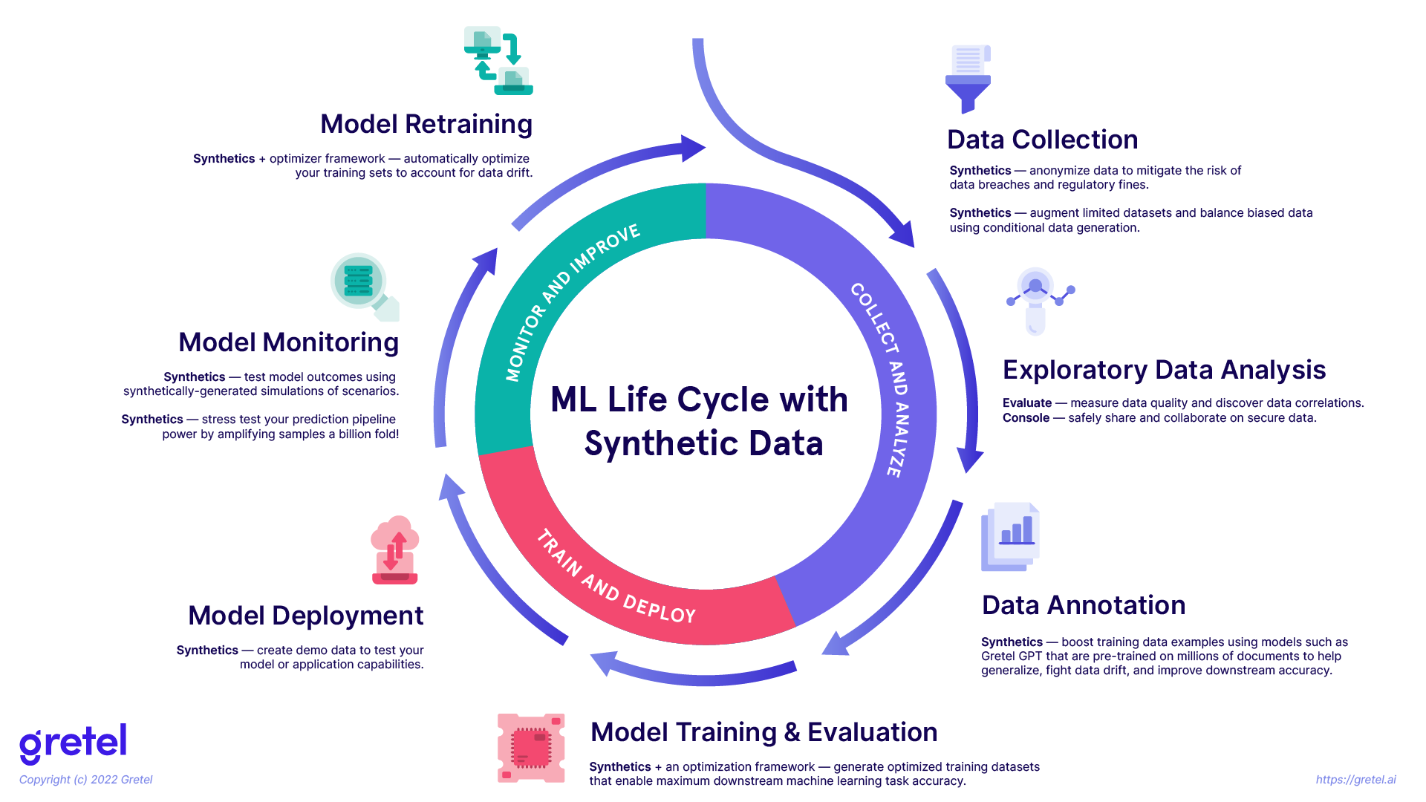
Machine Learning Lifecycle

Slide 40
Exercise

Slide 41
Exercise
What are your five key findings about the current trends in Artificial Intelligence? How could these trends potentially alter the technological landscape in the future?

Slide 42
References

Slide 43
References
AI vs. Machine Learning: How Do They Differ? (n.d.). Google Cloud. Retrieved November 25, 2023, from https://cloud.google.com/learn/artificial-intelligence-vs-machine-learning
Brooks, R. (2021, December 20). What is reinforcement learning? University of York. https://online.york.ac.uk/what-is-reinforcement-learning/
Hellström, I. (2020). A Tour of End-to-End Machine Learning Platforms. KDnuggets. https://www.kdnuggets.com/a-tour-of-end-to-end-machine-learning-platforms
Javatpoint. (n.d.). Regression vs Classification in Machine Learning. Javatpoint. Retrieved November 25, 2023, from https://www.javatpoint.com/regression-vs-classification-in-machine-learning
Khoong, W. H. (2023, June 15). Dimensionality Reduction Techniques For Categorical & Continuous Data. CodeX. https://medium.com/codex/dimensionality-reduction-techniques-for-categorical-continuous-data-75d2bca53100

Slide 44
References
Kumar, A. (2022, December 5). Difference between Online & Batch Learning. Analytics Yogi. https://vitalflux.com/difference-between-online-batch-learning/
Lewton, G. (2023, August). What Is Regression in Machine Learning? Enterprise AI. https://www.techtarget.com/searchenterpriseai/feature/What-is-regression-in-machine-learning
Raschka, S. (2018). Introduction to Machine Learning. STAT 479: Machine Learning. https://sebastianraschka.com/pdf/lecture-notes/stat479fs18/01_ml-overview_notes.pdf
SEKER, S. E. (2019, December 20). Hands-on End-to-End Automated Machine Learning. Medium. https://towardsdatascience.com/hands-on-end-to-end-automated-machine-learning-a50e6bce6512

